Slide 1
File Management & D.M.A.

Slide 2
File management is what you have and how you want to manipulate it. Anonymous

Slide 3
Why file management required?
In real life we want to store data permanently so that later we can retrieve it and can reuse it.
A file is a collection of characters stored on a secondary storage device like hard disk or pen drive.
There are two kinds of files that programmers deal with:
1. Text file : human readable format, English characters
2. Binary file : computer readable, contains 0 & 1 only
Binary file
010100100101001010101010
Text file
Hello, how are you? I’m text file.

Slide 4
File opening Modes
Mode | Description
r | Opens a file for reading. File must exist, else error.
w | Opens a file for writing. If file exists, it is overwritten; if not, a new file is created.
a | Opens a file for appending. Data is added at the end of file. Creates file if it doesn't exist.
r+ | Opens a file for reading and writing. File must exist.
w+ | Opens a file for reading and writing. Overwrites existing file or creates new one.
a+ | Opens a file for reading and appending. Data added to end. Creates file if not present.

Slide 5
File Handling Modes
Function | Description
fopen() | Used to open a file in a specific mode (r, w, a, etc.). Returns a file pointer if successful, otherwise NULL. Example: FILE *fp = fopen("data.txt", "r");
fclose() | Closes the opened file and frees up the memory associated with it. Always close files after operations. Example: fclose(fp);

Slide 6
File Handling Modes
Function | Description
fprintf() | Writes formatted output to the file, just like printf() but directed to a file. Example: fprintf(fp, "Name: %s\n", name);
fscanf() | Reads formatted input from a file, similar to scanf() but for files. Example: fscanf(fp, "%d", &age);

Slide 7
File Handling Modes
Function | Description
getc() | Reads a single character from the file. Returns an int or EOF. Example: char ch = getc(fp);
putc() | Writes a single character to the file. Example: putc('A', fp);

Slide 8
File Handling Modes
Function | Description
getw() | Reads an integer from the file. Mostly used with binary or integer-based files. Example: int x = getw(fp);
putw() | Reads an integer from the file. Mostly used with binary or integer-based files. Example: int x = getw(fp);

Slide 9
File Handling Modes
Function | Description
EOF | Stands for End Of File. It is returned when reading a file reaches the end. Commonly used in loops to stop reading. Example: while ((ch = getc(fp)) != EOF) { /* read file */ }

Slide 10
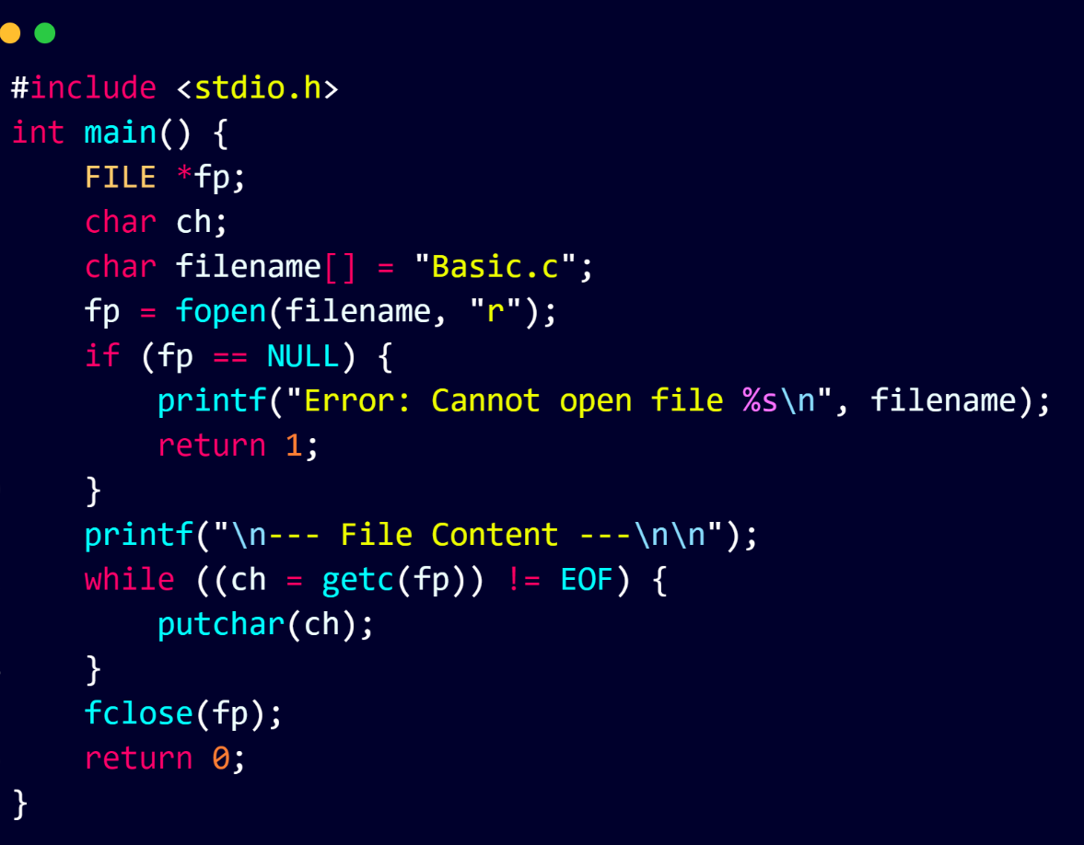
C Program to Display the Content of a Given File

Slide 11
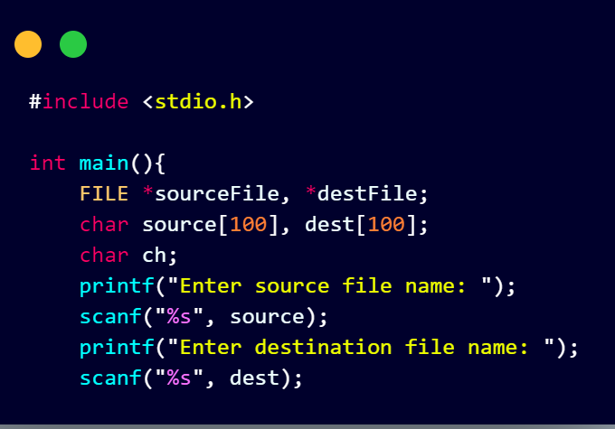
Copy one file into another file
First ask user for source and destination

Slide 12
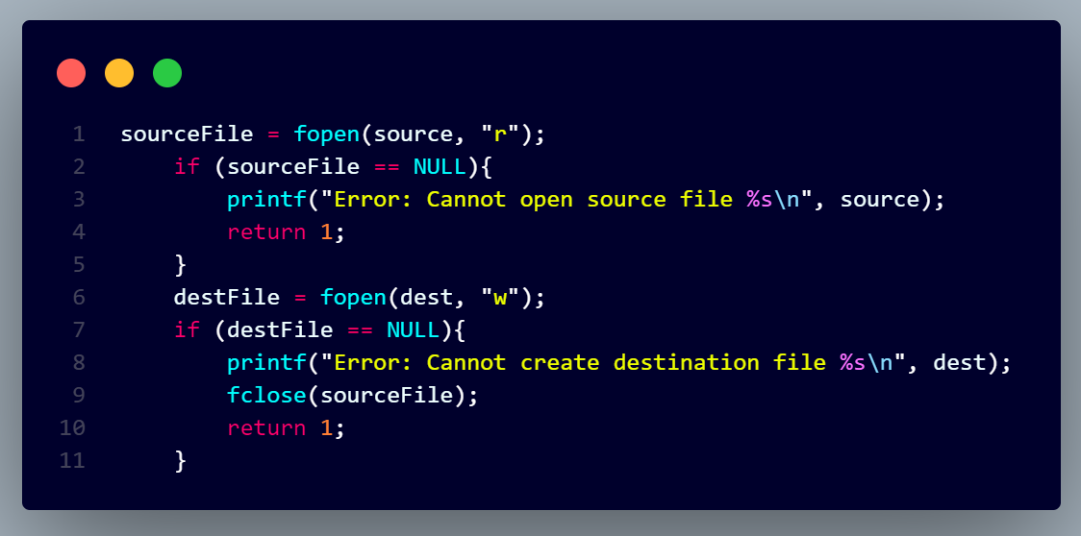
Check we can open and Create file?

Slide 13
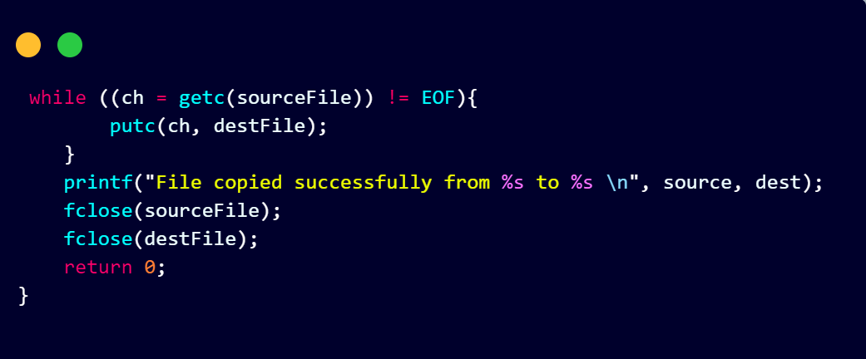
Now Copy the file

Slide 14
File Positioning Functions
Function | Description + Example
fseek() | Moves the file pointer to a specific location from beginning, current, or end of file. Example: fseek(fp, 0, SEEK_SET); // Move to beginning
ftell() | Returns the current position of the file pointer in bytes from the beginning. Example: long pos = ftell(fp);
rewind() | Sets the file pointer back to the beginning of the file (same as fseek(fp, 0, SEEK_SET);). Example: rewind(fp);

Slide 15
Dynamic Memory Allocation (D.M.A.)

